Slide 1
SYSTEM ARCHITECTURE
InteriorFlow
Manufacturing Process Control System
End-to-end module flow from initial setup to final site delivery.

Slide 2
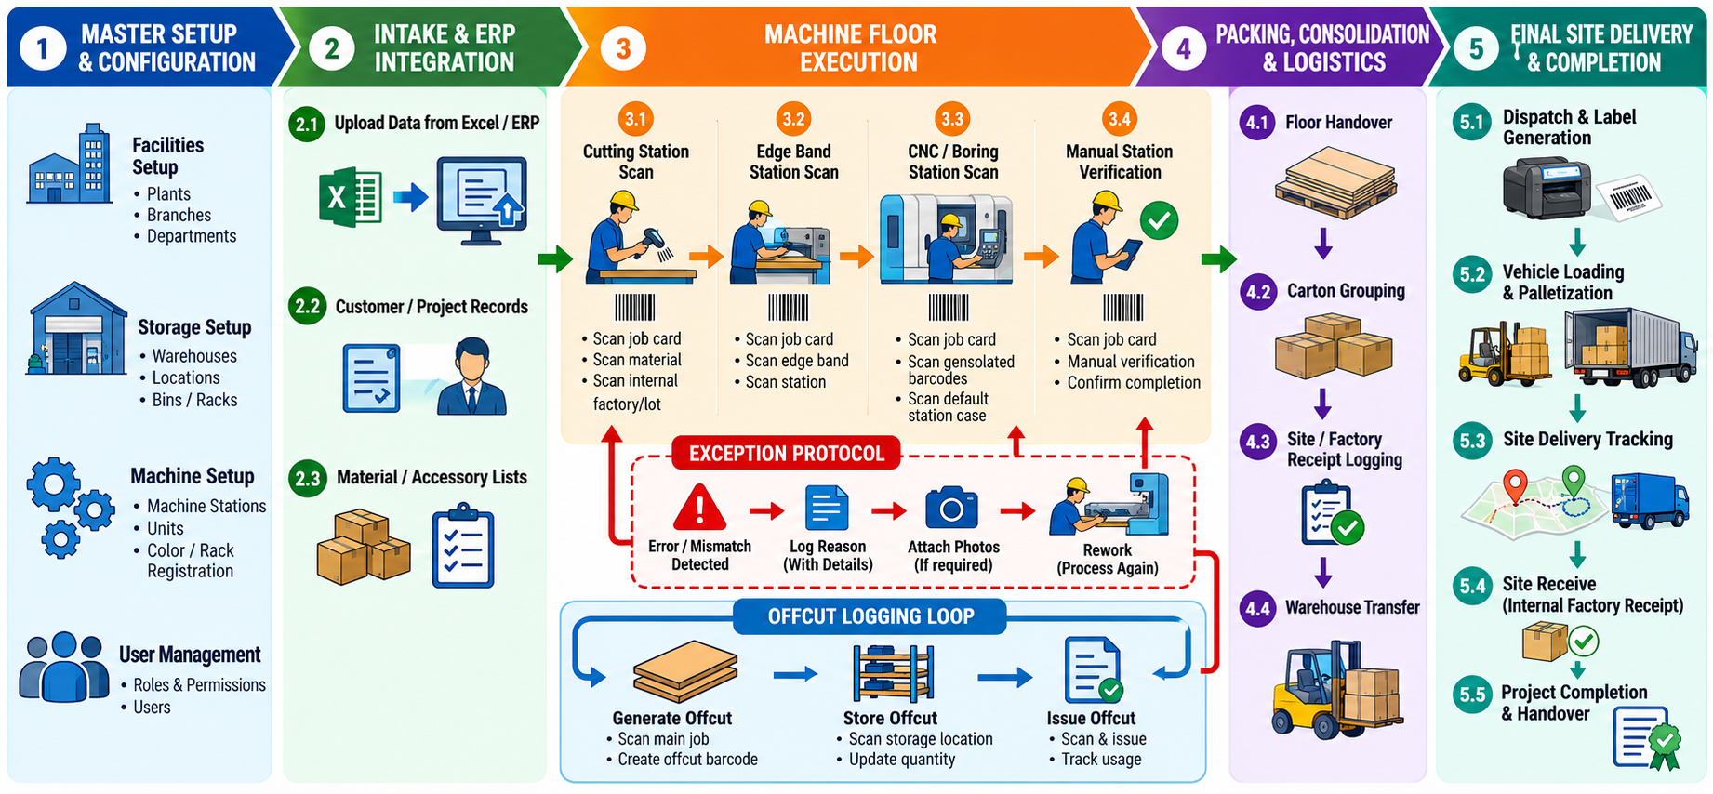










Complete Application Lifecycle
Setup
Intake
Routing
Machine Floor
Packing
Dispatch
Receive

Slide 3



MODULE 01
Base Data Setup
Facilities
Operations
Rules & Users
Define operational branches.
Configure machine stations.
Create user profiles.
Register production factories.
Set measurement units.
Define storage racks.
Establish storage warehouses.
Register panel colors.
Log exception reasons.

Slide 4
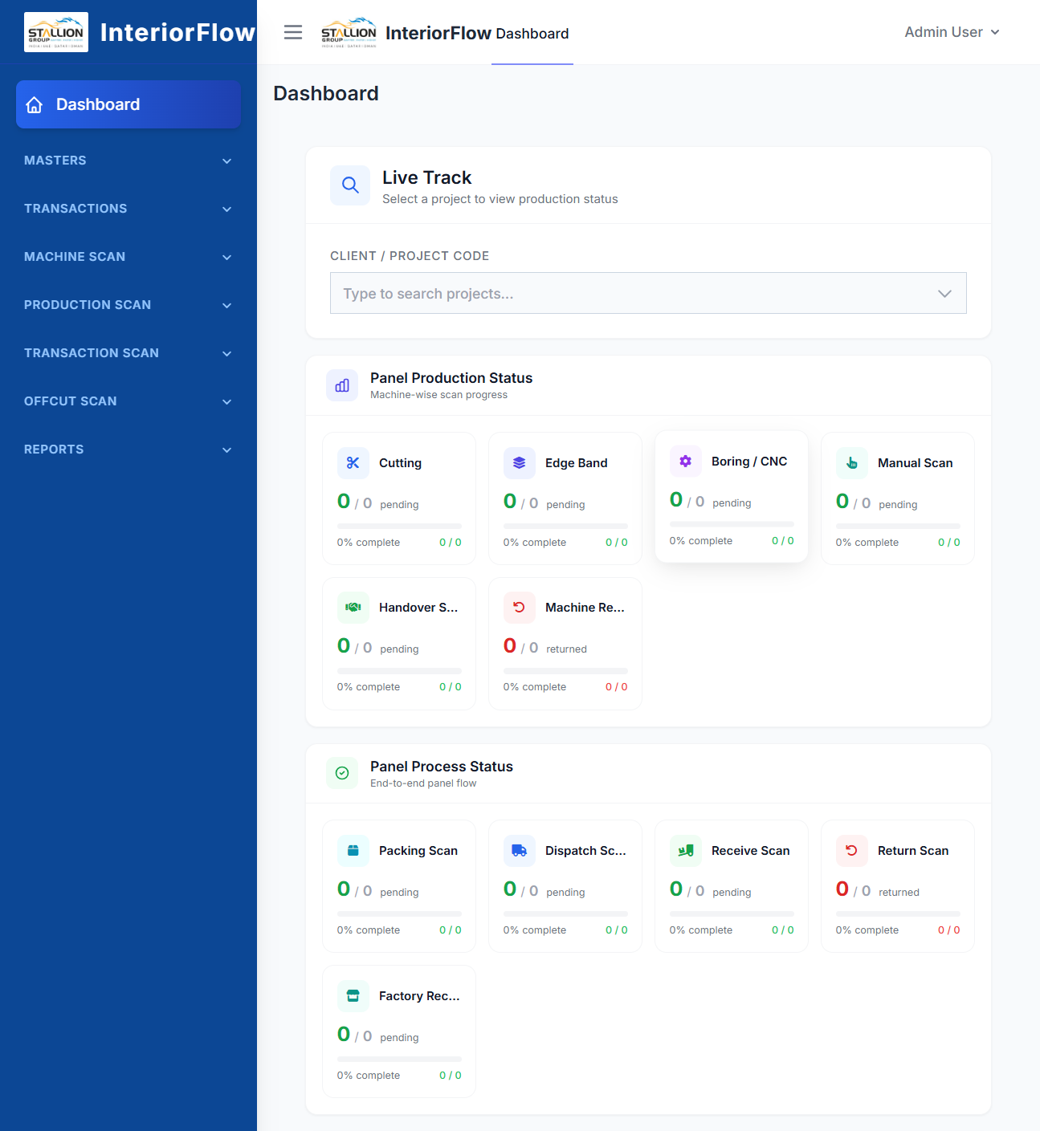
MODULE 02 & 03
Intake & Routing
Data Upload/ ERP integration
Excel ingestion or ERP integration automatically generates customer and project records.
Identity & Materials
Unique barcode assignment and material/accessory list synchronization.
Dynamic Routing
Auto-assign machine paths based on panel type and edge configuration.

Slide 5
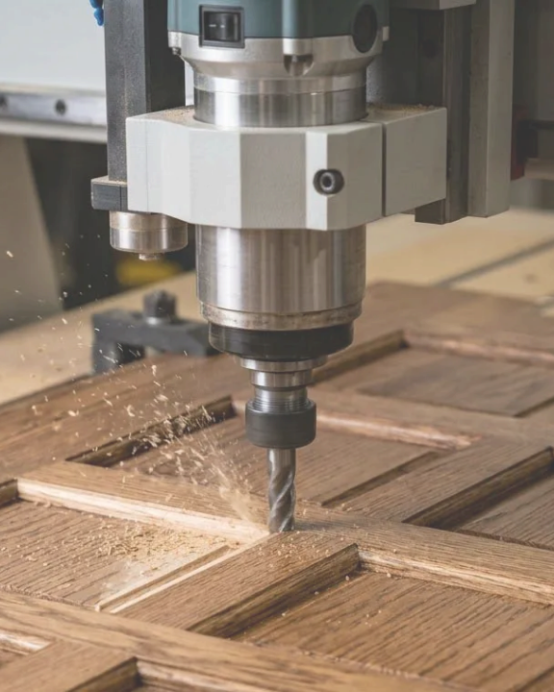
MODULE 04
Machine Floor Execution
1
Cutting Station Scan
2
Edge Band Station Scan
3
CNC / Boring Station Scan
4
Manual Station Verification
Exception Protocol
Operators can skip or return problem panels directly via scanner, requiring a logged reason and photo attachment.

Slide 6






MODULE 05
Offcuts Management Loop
Generate
Store
Issue
Select color, input length/width, and print barcode label for the cut.
Scan the offcut barcode and its designated destination rack.
Retrieve logged offcuts directly into production for material reuse.

Slide 7
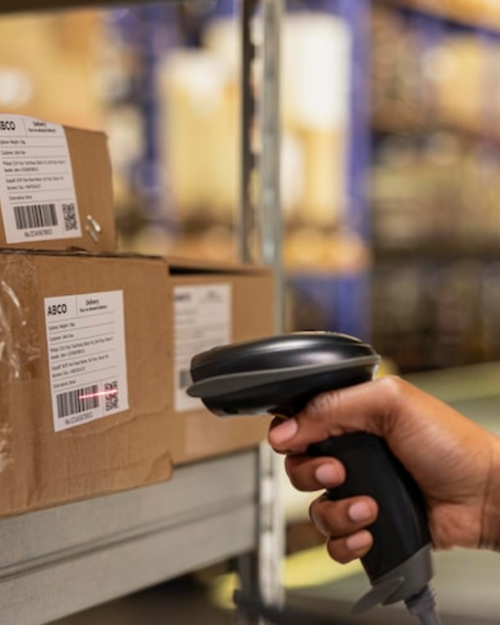
MODULE 06
Packing Consolidation
Floor Handover
Hierarchy Grouping
Accept verified panels from machine floor.
Nest panel and material barcodes under parent cartons.
Frame Doors
Rework Routing
Assemble and produce designated frame doors.
Send defective panels back to machine floor.

Slide 8
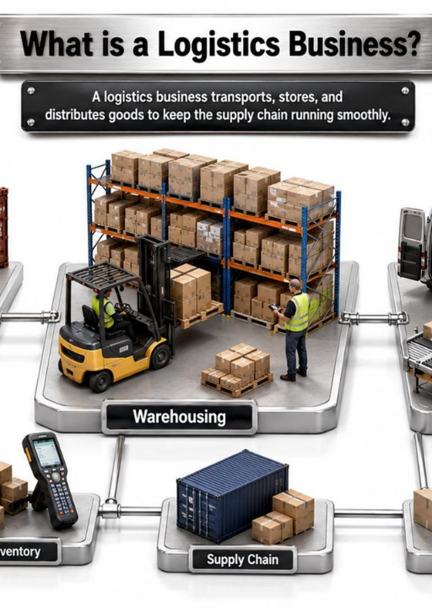


MODULE 07
Logistics & Dispatch
Warehouse Transfer
Internal logistics between holding facilities.
Site Delivery
Dispatch consolidated cartons to final destination.
Receipt Confirmations
Customer site receive and internal factory receipt logging.
Returns Handling
Process returned panels via dedicated return scans.

Slide 9
Business Benefits
Production Visibility & Control
Material & Cost Efficiency
Data-Driven Decisions
Quality & Rework Management
Centralized data enables reporting on machine utilization, bottlenecks, defect rates, offcut reuse, and on-time delivery
Real-time knowledge of every panel's location and stage — no reliance on paper travellers or verbal updates
Offcut generate-store-issue workflow turns scrap into searchable, reusable inventory instead of waste
Skip/return with reason and photo at each station builds a traceable defect history by machine, shift, or operator
Barcode tracking removes ambiguity between similar-looking panels across large, multi-panel projects
Rack-based offcut storage means staff can actually find and reuse material, cutting fresh-material costs
Historical data supports more realistic lead-time planning for future projects
Photo evidence reduces disputes about what went wrong and when
Automatic machine routing (by panel type/edges) eliminates manual routing errors and guesswork on the floor
Logistics & Delivery Accountability
Scalability
Inventory & Warehouse Accuracy
Modular setup (units, branches, warehouses, factories, machines) allows expansion to new locations without redesigning the workflow
Full chain of custody — transfer, delivery, receipt, factory receipt, and return scans — shows exactly what left, arrived, and came back
Scanning at every handover (floor → packing → warehouse → site) keeps stock counts accurate without manual reconciliation

Slide 10

End-to-End Visibility
From base configuration to final site delivery.

